Slide 1
Lesson 22 – Homework review

Slide 2
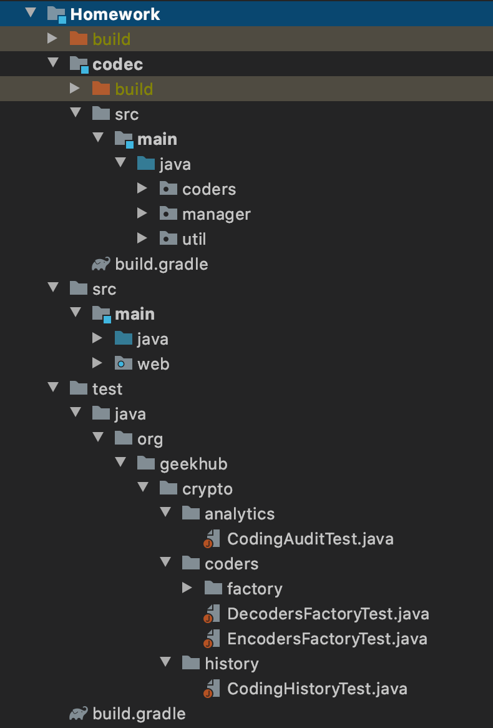
Project Code Structure is IMPORTANT

Slide 3
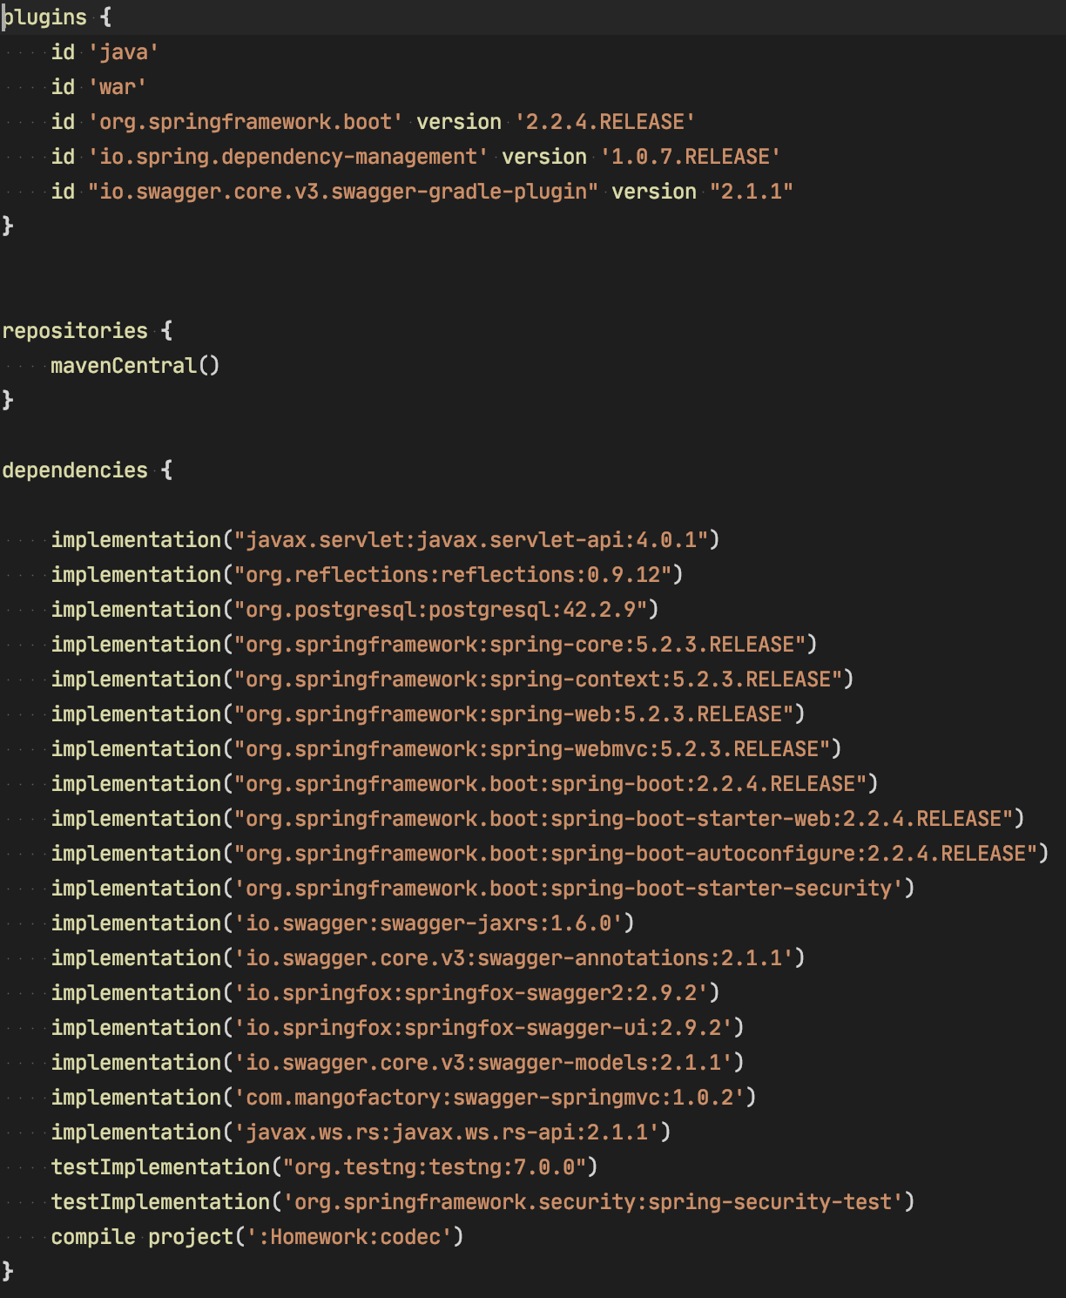
Dependencies HELL 👿

Slide 4
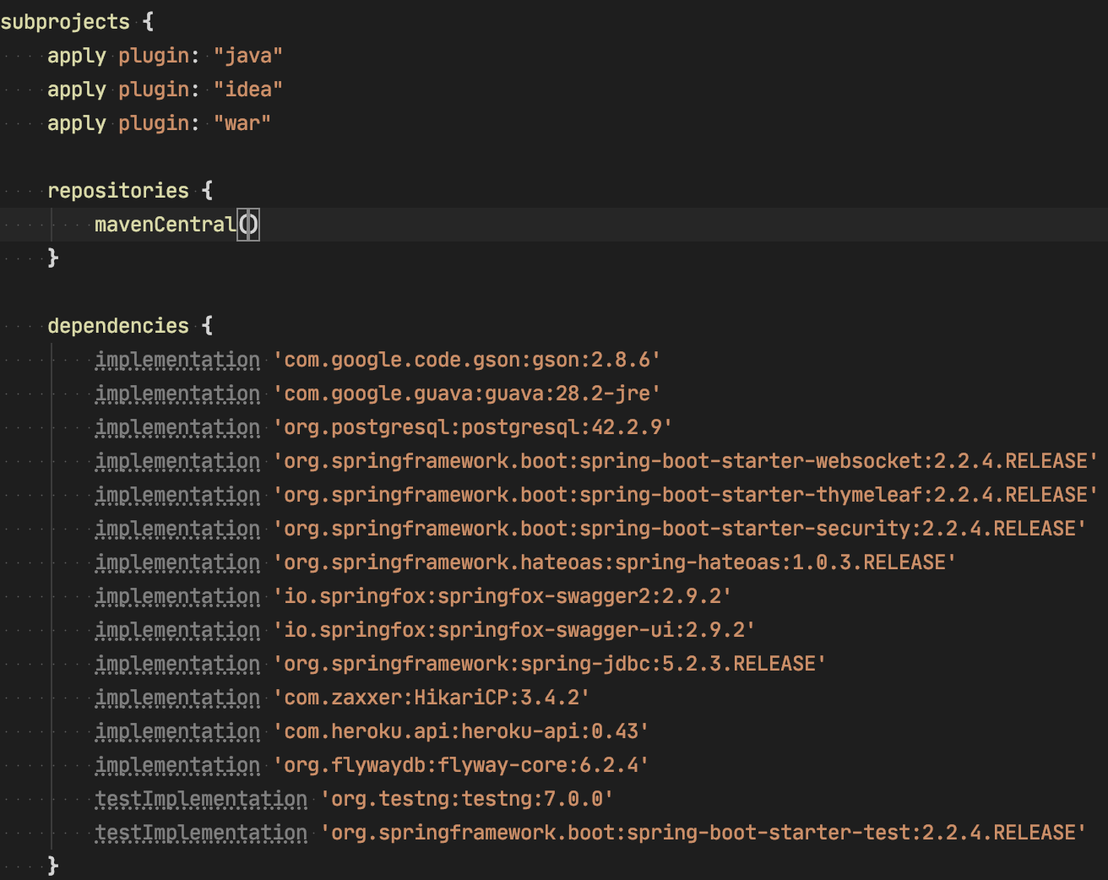
Careful usage of “subprojects” config

Slide 5
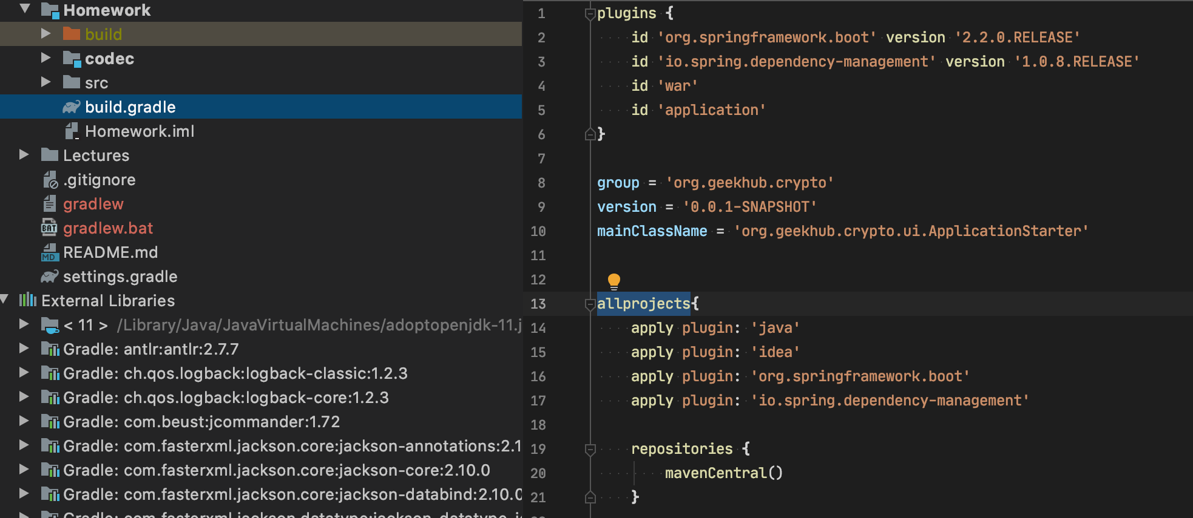
Careful ” allprojects” usage

Slide 6
Apply recommendations from personal feedbacks before starting next homework

